Slide 1
How to Apply for the APD Med-Waiver

Slide 2
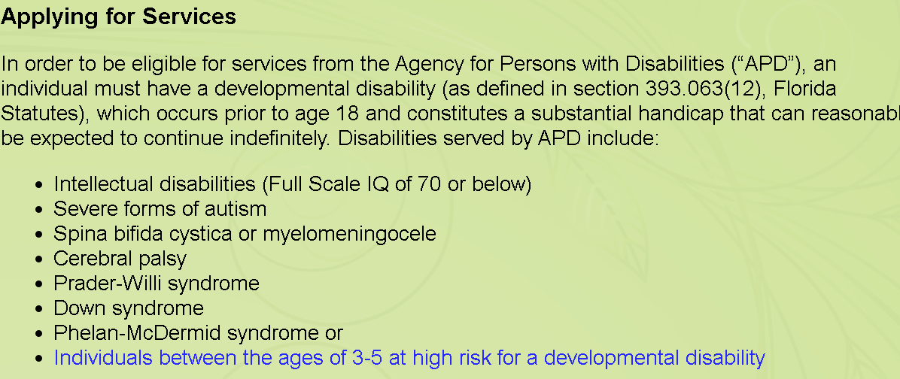
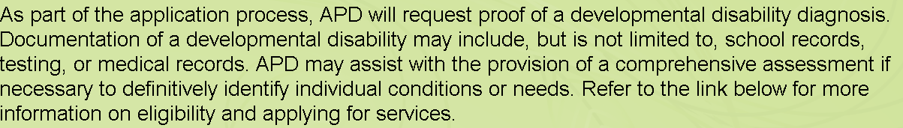
Are you eligible for the Med-Waiver ?
Mechanical pencils
are also allowed!

Slide 3
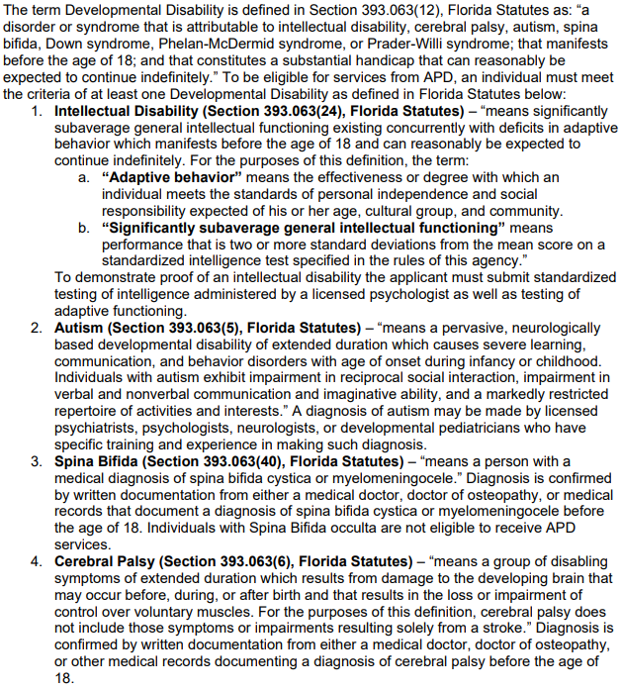
Disability Definitions
Is your disability listed? If not do not worry.

Slide 4
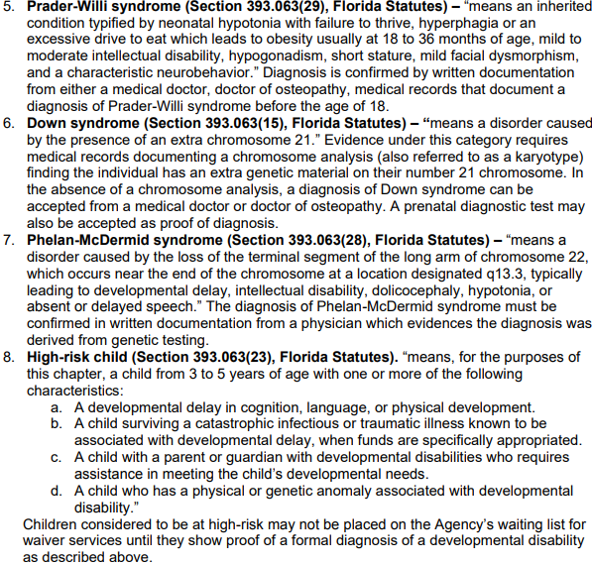
Disability Definitions
Is your disability listed? If not do not worry.
CONTINUED -

Slide 5
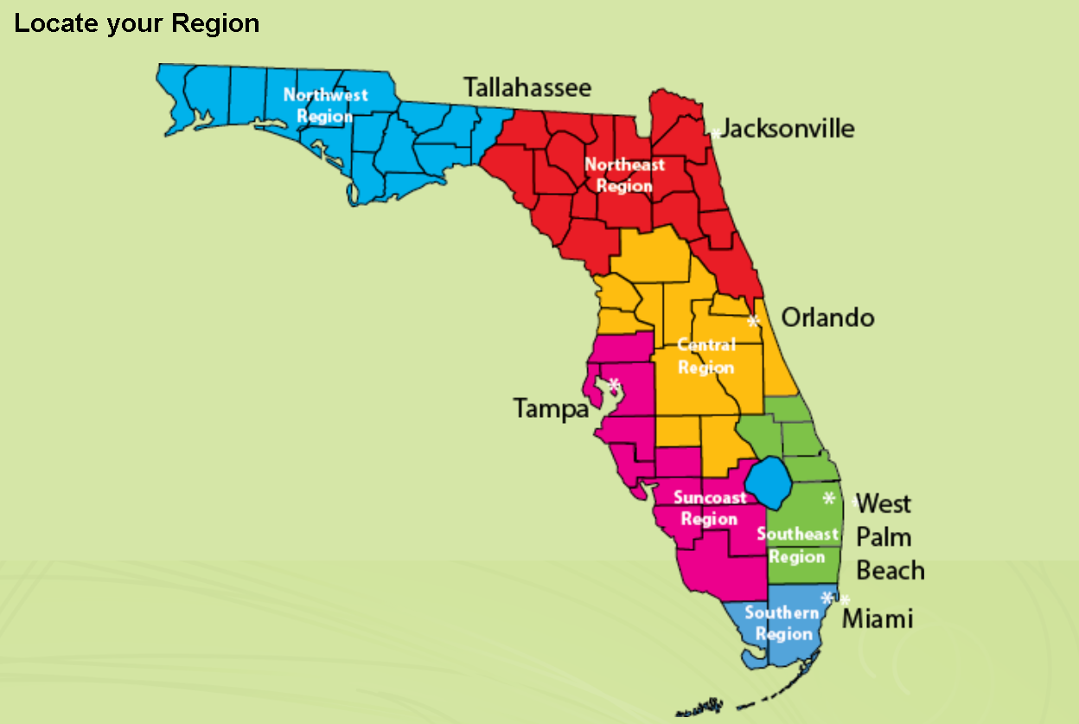


Applying for Services | Customers (myflorida.com)
Please follow the link below to access the waiver application link.
You will need to utilize Adobe acrobat reader . If you do not have the app please use the link to download Adobe - Adobe Acrobat Reader DC Download | Free PDF viewer for Windows, Mac OS, Android
Please select the link Attachment-D-Application for Services 17-09-06.pdf (myflorida.com) to complete the application to complete services.
If you have the proof of eligibility that you can provide with your application, it will streamline the eligibility review process. Otherwise, APD will assist you in obtaining the information.

Slide 6
Learn
Your
Region
Northwest Region | APD - Agency for Persons with Disabilities - State of Florida (myflorida.com)
Northeast Region | APD - Agency for Persons with Disabilities - State of Florida (myflorida.com)
Central Region | APD - Agency for Persons with Disabilities - State of Florida (myflorida.com)
Suncoast Region | APD - Agency for Persons with Disabilities - State of Florida (myflorida.com)
Southeast Region | APD - Agency for Persons with Disabilities - State of Florida (myflorida.com)
Southern Region | APD - Agency for Persons with Disabilities - State of Florida (myflorida.com)

Slide 7



Once the application is completed you will submit it.
Please follow the steps to submit the application
To apply for services from the Agency for Persons with Disabilities, which includes participation in the IBudget Home and Community-Based Services Waiver or placement in an intermediate care facility for individuals with intellectual or developmental disabilities (ICF/IID), submit an application to the APD office that serves your area, either by mail or by hand delivery. Faxed submissions will be returned for an original signature.
Application for services may be accepted from a parent or court-appointed
guardian of a minor child, a legally competent adult, or an authorized legal
representative. For applicants under 18 years of age, the person’s legal
representative must sign the application for APD services. If the applicant is
18 years of age or older, he or she must sign the application and all necessary
documents unless he has been determined incapacitated by a court of law or
unless he has asked another person to exercise his rights (in writing).
An adult who is unable to sign may mark the signature line. The mark shall be
identified and witnessed as “his/her mark.” If the adult is incapacitated, the
legal representative, as identified in a court order, shall execute all documents on
behalf of the applicant.

Slide 8

CRISIS CRITERIA
Applicants who are in crisis (meaning they’re currently homeless,
exhibit life-threatening behaviors that place them or others in extreme
danger, or have a caregiver who is in extreme duress and can no longer
provide for the applicant’s health and safety) should contact the Agency
for Persons with Disabilities’ regional office serving their county. The local
regional office may be able to provide short term services and will review
the situation to determine if a crisis waiver enrollment request is warranted.
For more information regarding crisis criteria, please visit the
Florida Administrative
Code & Florida Administrative Register website at:
https://www.flrules.org/gateway/ChapterHome.asp?Chapter=65G-1
If you know some one that meets the above criteria, please make sure that this is reported immediately.

Slide 9




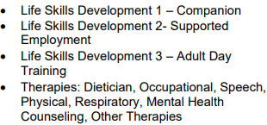


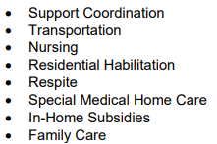



WHAT SERVICES DOES APD OFFER ?

Slide 10
What to know about the
Waiting List For APD
Waitlist | Customers (myflorida.com)
The Waiting List for waiver services is defined in Section 393.065(5), Florida Statutes and consists of the categories defined in the document titled Waiting List Priority Categories found below. The document titled Waiting List Prioritization Tool was developed by the agency in conjunction with various stakeholders from around the state. It is defined in the law as the mechanism by which the agency will determine who will receive offers for waiver enrollment when the agency has funding for enrolling individuals from the waiting list to the Florida iBudget waiver.
If you are currently on the Agency’s waiting list for the iBudget Waiver
program and there has been a change in circumstance or if you are in
immediate need of services, please contact your local APD Regional
office (click here for contact information) and request to speak to your
assigned worker. You may also print the Annual Status Review form
(click here to download) and provide us with an update. Also, be sure
to check out these resources here if you are currently on the waiting
list or do not qualify for APD services.

Slide 11
Resources for those on the wait list or individuals not eligible for APD Services.
There are resources in Florida for people who are not eligible for APD services and those waiting for services. The APD Resource Directory is a tool for individuals to learn about the available resources and organizations available in their local areas, programs offered throughout the state, and nationwide resources.
Visit: https://apd.myflorida.com/resourcedirectory The APD Florida Navigator is an online tool designed to empower and inform individuals with developmental disabilities, caregivers, and professionals about specific State of Florida services. Visit: https://navigator.apd.myflorida.com/
Apply for Medicaid or other public assistance programs through the Department of Children and Families Access program.
Visit: https://dcf-access.dcf.state.fl.us/access/index.do Florida Kidcare offers healthcare coverage for children from birth to age 18. There are 4 possible programs, including: Medicaid, MediKids, Florida Healthy Kids, or the Children’s Medical Services Managed Care Plan. For more information, please contact Florida Kidcare at 1-888-540-KIDS (5437) or
visit their website at: https://www.floridakidcare.org/
Visit: apdcares.org Toll-Free: 1-866-APD-CARES (1-866-273-2273

Slide 12
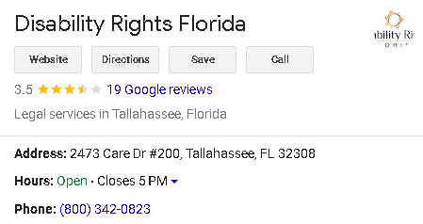
Med-Waiver not a fit , other resources are available.
This Agency helps with application to the Med-Waiver and the Long-Term Waiver for Florida.
They offer an online intake , videos to show the assistance offered and resources to help you and your loved one.
Disability Rights Florida

Slide 13
Thank You ☺
We hope this information assist in understanding the process to gaining assistance for you and your loved one.

